Slide 1
Privacy and Security in IoT
Pixels Camp 2017

Slide 2


The speaker
Vasco Veloso
vveloso@gmail.com
Worked from the kernel to the cloud.
Wrote a book on x86 assembly.
Built firmware for embedded systems.
Writing and designing software professionally since 1997.
Currently a Java software architect at Coriant Portugal.

Slide 3
Nothing is unbreakable…
… but we can make it more difficult to break!

Slide 4
Why is this important?
Old concern
Regulation attempts date back to 2008 in the EU.
Remember all the talk around RFID?
20 billion connected “Things” in 2020 (Gartner)
20 billion new nodes ripe for attacking.
20 billion new nodes surveilling each and every one of us.

Slide 5
Security risks
Device supply chain
Devices may be resold pre-programmed with malware.
Firmware upgrade
OTA may be abused.
Applications and services
Exposed services and end-user applications may be compromised.
Working network
User networks are hostile by definition.
Cloud service impersonation

Slide 6
Physical risk mitigation
Remove or limit access to debug and programming ports.
Some vendors provide authorization on debug ports.
Re-evaluate vendor designs.
Remove unnecessary connections and peripherals.
Study device flash memory protection mechanisms.
Memory/storage encryption and write control.
Use cryptographic hardware.
Detect tampering attempts.

Slide 7
Software risk mitigation
Use secure development practices for the platform and language.
Trim and re-evaluate third-party software and libraries.
Use sound and proven cryptographic implementations.
Secure the boot process.
Authenticate OTA update sources and targets.
Have distinct device signatures for software updates.
Pair external devices, such as phones, securely to NFC/Bluetooth.

Slide 8
Network risk mitigation
Different default credentials for all devices.
Security on the protocol level.
Peer authentication and authorization.
Secret sharing
Cryptographic one-way hashing
Zero knowledge proof
Nodes act only as clients towards the network.

Slide 9
Privacy risks
Identity disclosure
Device may transmit personally identifiable data.
Device transmissions may be recognizable.
Location disclosure
Device may transmit its explicit location.
Device may be itself traceable through its communications.
Data confidentiality
Cloud services may contain records full of personally identifiable data.

Slide 10
Privacy risk mitigation
Identity disclosure
Pseudonym.
Connection anonymization.
Location disclosure
Pseudonym.
Data confidentiality
No direct access to personally identifiable data from devices.
Secure data center / cloud resources.

Slide 11
Security and privacy first
Security and privacy are first-class requirements.
Design from the start with them in mind.
Define trust boundaries
Device/gateway, gateway/cloud, …
Imagine unlawful ways of interacting with the system
Threat modeling

Slide 12
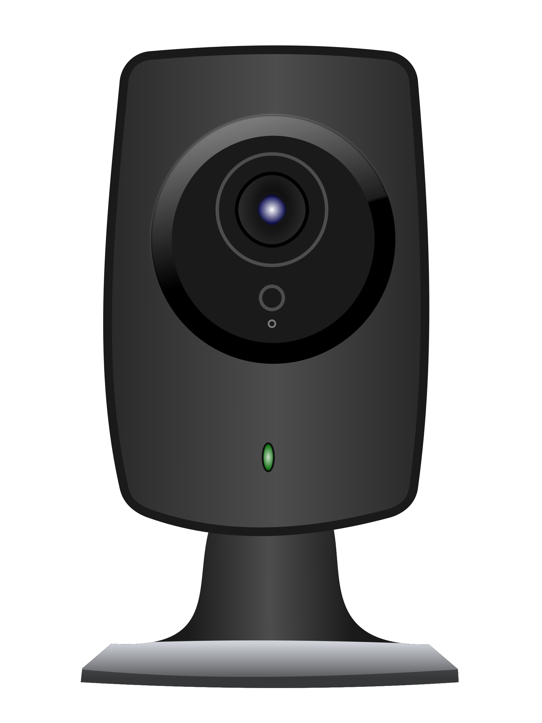
Did it happen before?
120k IP cameras at risk of attack
(September 2017)
Persirai leverages a zero-day vulnerability to gain access and UPnP to connect to the device.
https://www.darkreading.com/attacks-breaches/new-iot-botnet-discovered-120k-ip-cameras-at-risk-of-attack/d/d-id/1328839

Slide 13
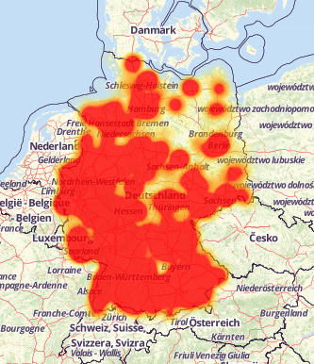
Did it happen before?
Over 900k routers compromised in Germany
(November 2016)
Remote management was left enabled for the world at large.
A variant of the Mirai worm was busy using well known credentials to change the routers’ firmware.
Allestoerungen.de and OpenMaps
http://securityaffairs.co/wordpress/53871/iot/deutsche-telekom-hack.html

Slide 14
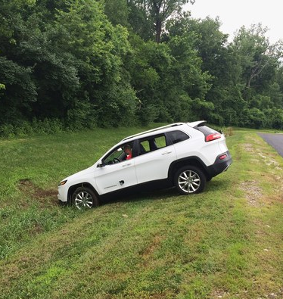
Did it happen before?
Jeep hacked remotely
(July 2015)
Zero-day vulnerabilities that allowed remote control of a Jeep Cherokee were demonstrated to the press.
Andy Greenberg / Wired
https://www.wired.com/2015/07/hackers-remotely-kill-jeep-highway/

Slide 15
Did it happen before?
Remotely controlled car washes
(July 2017)
Attackers can take control of the machine by leveraging plain text HTTP connections and default credentials.
Physical damage to property and humans becomes possible.
https://motherboard.vice.com/en_us/article/bjxe33/car-wash-hack-can-smash-vehicle-trap-passengers-douse-them-with-water

Slide 16
General Data Protection Regulation (EU)
Privacy by design and by default!
Minimize data collection.
Hide data.
Encrypt.
Anonymize.
Pseudonymize.
Control access to data.
Have a privacy policy.
Have means of determining the extent of privacy braches.

Slide 17
General Data Protection Regulation (EU)
Data subjects have rights:
Information
Access
Update
Object
Erasure
Export
Portability

Slide 18
That’s all folks
Slides and reference papers available at
https://github.com/vveloso/talks
http://linkedin.com/in/vascoveloso
vveloso@gmail.com

